Slide 1
Artificial Intelligence

Slide 2
What is Artificial Intelligence
A branch of computer science dealing with simulation of intelligent behavior in computer.
The capability of machine to imitate intelligent human behavior.
Artificial intelligence is exhibited by machine.
The term can also refer to the study science and engineering of such intelligent machines system and program.
The theory and development of computer system able to perform task normally requiring human intelligence.

Slide 3
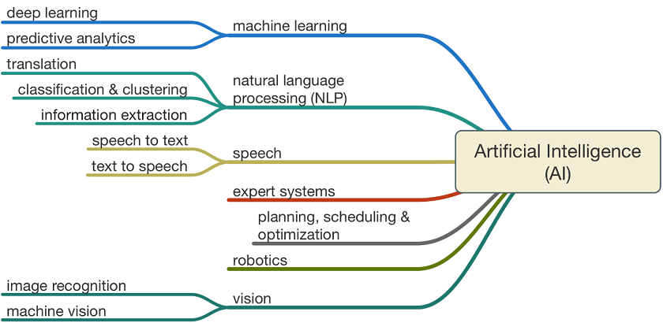
Working of AI

Slide 4
Use of Artificial Intelligence
AI application
Robotics
Natural language processing
Speech recognition
Intelligent agent
Bot
Artificial creativity
Intelligent agent

